Slide 1
Methods I Lab Lecture 5

Slide 2
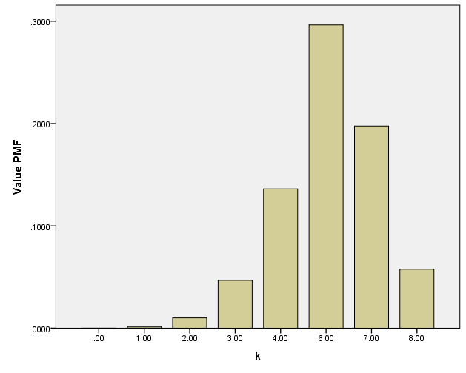
Binomial Distribution - Exercise

Slide 3
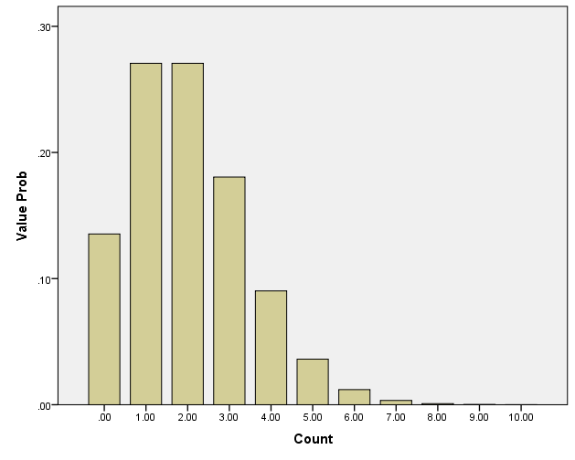
That distribution that’s fishy… Poisson (at it’s finest)
As a distribution, it has the 2nd coolest name
The 1st being Cauchy
The Poisson distribution is used to model count data
Historically, it was used to model the number of deaths by horse kicking in the Prussian army
Nowadays, it is commonly used to model duration of hospital stays (in days), death count, and more

Slide 4
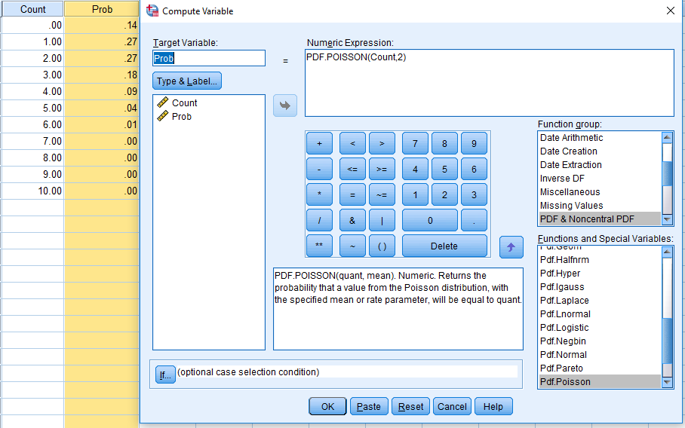
Poisson - Exercise
Make a variable, Count, that goes from 0 to 10
Make a new variable
Prob = PDF.POISSON(Count,2)

Slide 5
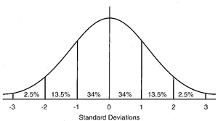
Standard Normal Distribution
The standard normal distribution has specific parameters
mean (μ) = 0
standard deviation (σ) = 1
Standard Normal Distribution is symmetric
E.g., P(X≤ -2) = P(X≥ 2) = 1- P(X ≤ 2)

Slide 6
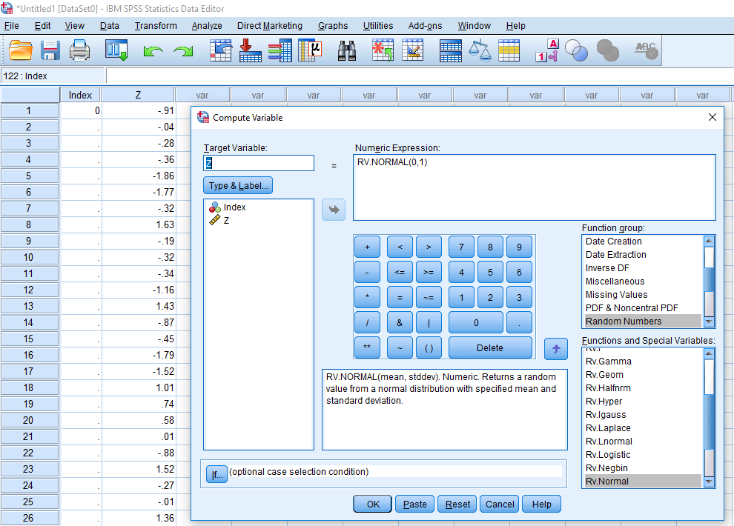
Standard Normal - Exercise
Enter ‘0’ at row 100+ for an index variable
Generate data from random standard normal
Transform
Compute Variable
RV.NORMAL(0,1)

Slide 7
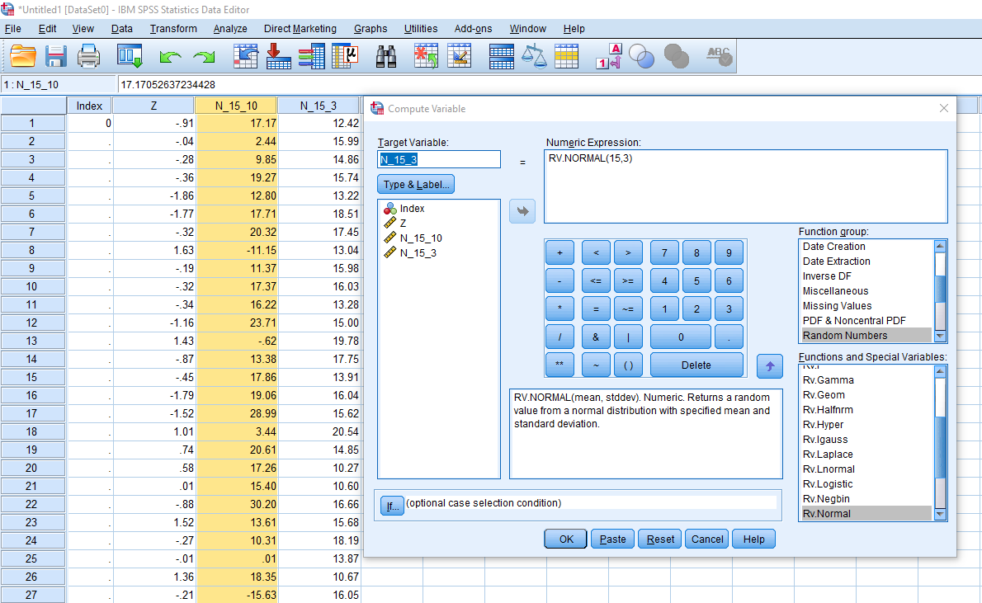
Normal - Exercise
Generate 2 variables from random normal distribution
1: Mean = 15, StdDev = 10
2: Mean = 15, StdDev = 3
Transform
Compute Variable
RV.NORMAL(15,10)
Transform
Compute Variable
RV.NORMAL(15,3)

Slide 8
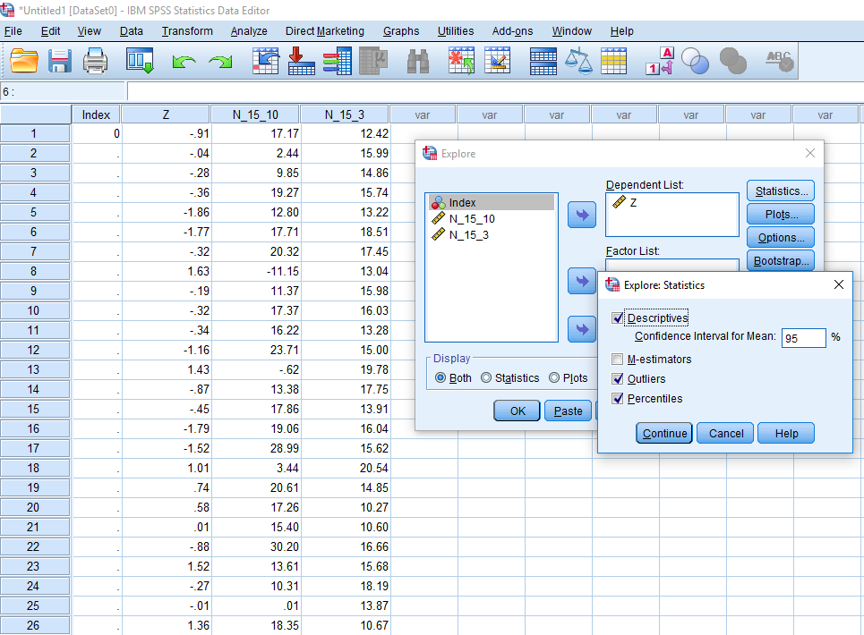
Standard Normal Distribution - Exercise
Find the Mean, Mean 95% CI, and the StdDev
Analyze
Descriptive Statistics
Explore…
Dependent = Z
Statistics
Descriptives
Plots
Histogram

Slide 9
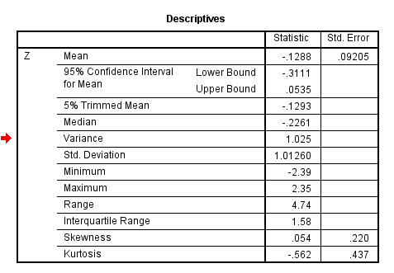
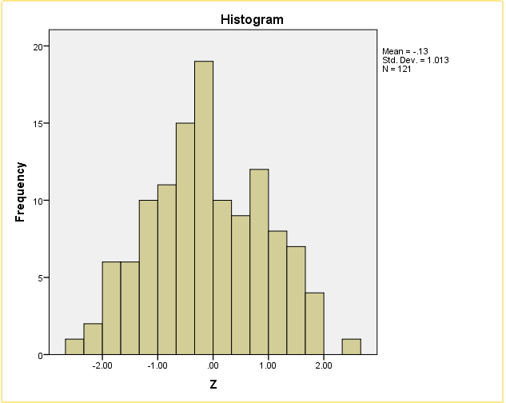
Standard Normal Distribution - Exercise
Verify that everything is as expected
Is the mean approximately 0?
Is the StdDev approximately 1?
Does the data appear normally distributed?
?

Slide 10
Normal Distribution - Exercise
Find the Mean, Mean 95% CI, and the StdDev
Analyze
Descriptive Statistics
Explore…
Dependent = N_15_10 and N_15_3
Statistics
Descriptives
Plots
Histogram

Slide 11
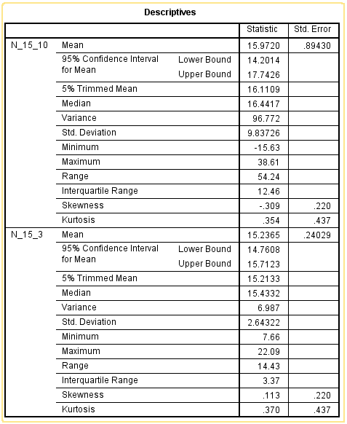
Normal Distribution - Exercise
Standardize the N_15_3 variable.
Transform
Compute Variable

Slide 12
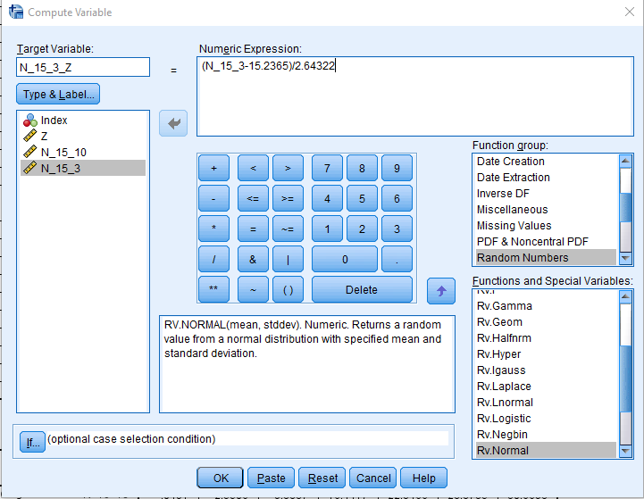
Normal Distribution - Exercise
Standardize the N_15_3 variable.
Transform
Compute Variable
Num. Exp.: (Variable - Mean)/StdDev

Slide 13
Normal Distribution : Standardize - Exercise
For the variable you just standardize, find the Mean, Mean 95% CI, and the StdDev
Analyze
Descriptive Statistics
Explore…
Dependent = N_15_3_Z
Statistics
Descriptives
Plots
Histogram

Slide 14
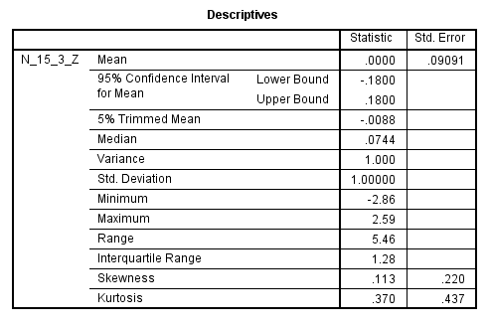
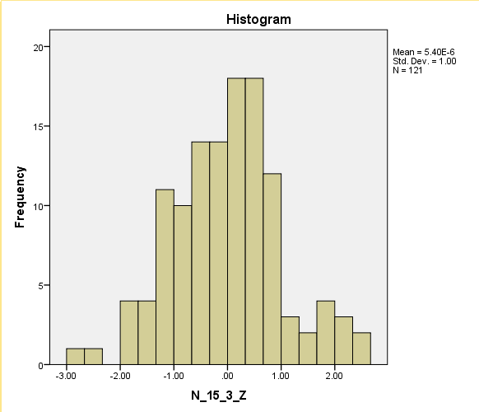
Normal Distribution : Standardize - Exercise
Verify that everything is as expected
Is the mean approximately 0?
Is the StdDev approximately 1?
Does the data appear normally distributed?
?

Slide 15
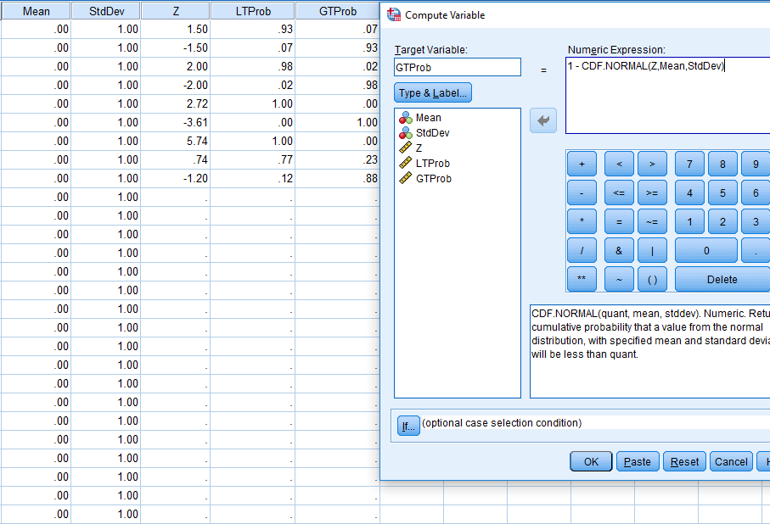
Normal Distribution - Probabilities
Create three variables, Mean, StdDev, and Z
Mean = 0
StdDev = 1
Z should alternate
Choose whatever you want
Calculate two variables, LTProb and GT Prob
LTProb = CDF.NORMAL(Z,Mean,StdDev)
GTProb = 1 - CDF.NORMAL(Z,Mean,StdDev)

